Slide 1
Customer Analytics
Exploratory Data Analysis
March 28, 2019

Slide 2
Today’s objective
To engage in the iterative process of transforming, visualizing, and modelling data from the juicelaundry package to answer questions (and develop better questions) related to the topics you are exploring for your group projects.
Notes:
w/Master - KK

Slide 3
Agenda
Around the 🌎
Your lessons learned
HW4 demo
Ch 7 run-through
Individual practice

Slide 4
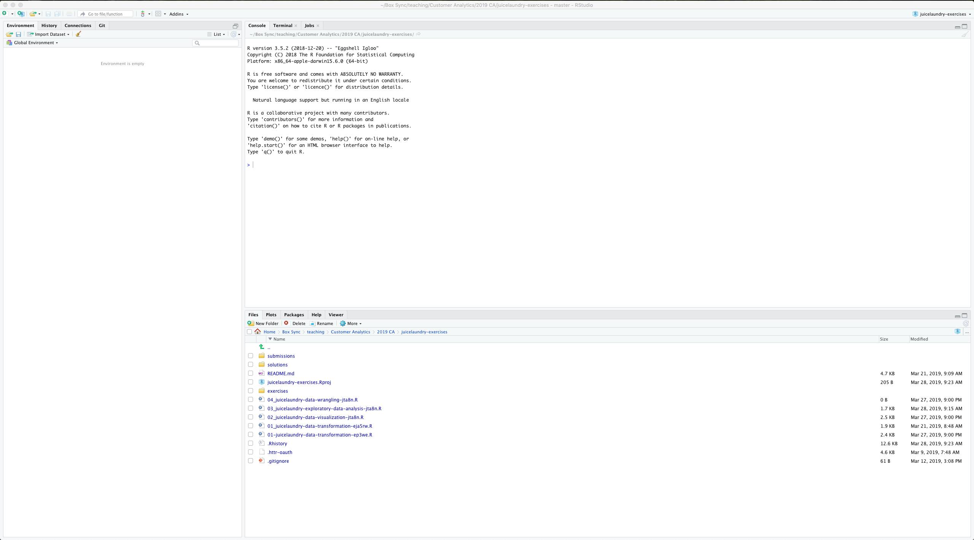

Slide 5

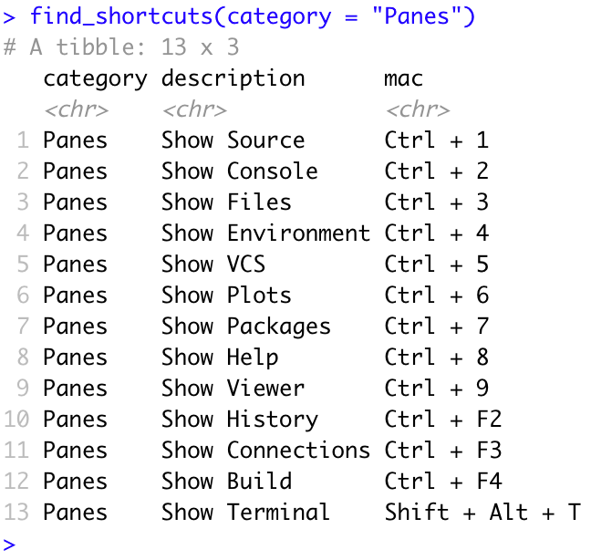
CrossR
Around the 🌎

Slide 6
Your Lessons Learned

Slide 7
HW4 Demo

Slide 8
Chapter 7 of R4DS
A run-through
EDA is fundamentally a creative process. And like most creative processes, the key to asking quality questions is to generate a large quantity of questions. It is difficult to ask revealing questions at the start of your analysis because you do not know what insights are contained in your dataset. On the other hand, each new question that you ask will expose you to a new aspect of your data and increase your chance of making a discovery. You can quickly drill down into the most interesting parts of your data—and develop a set of thought-provoking questions—if you follow up each question with a new question based on what you find.
Source: Wickham, Hadley and Garrett Grolemund (2017). R for Data Science. O;Reilly: Boston, MA.

Slide 9
Far better an approximate answer to the right question, which is often vague, than an exact answer to the wrong question, which can always be made precise.
John Tukey
https://r4ds.had.co.nz/exploratory-data-analysis.html#questions
Notes:
https://r4ds.had.co.nz/exploratory-data-analysis.html#questions

Slide 10
Chapter 7 of R4DS
A run-through
There is no rule about which questions you should ask to guide your research. However, two types of questions will always be useful for making discoveries within your data. You can loosely word these questions as:
What type of variation occurs within my variables?
What type of covariation occurs between my variables?
Source: Wickham, Hadley and Garrett Grolemund (2017). R for Data Science. O;Reilly: Boston, MA.

Slide 11
Chapter 7 of R4DS
A run-through
There is no rule about which questions you should ask to guide your research. However, two types of questions will always be useful for making discoveries within your data. You can loosely word these questions as:
What type of variation occurs within my variables?
Which values are the most common? Why?
Which values are rare? Why? Does that match your expectations?
Can you see any unusual patterns? What might explain them?
What type of covariation occurs between my variables?
Source: Wickham, Hadley and Garrett Grolemund (2017). R for Data Science. O;Reilly: Boston, MA.

Slide 12
Chapter 7 of R4DS
A run-through
There is no rule about which questions you should ask to guide your research. However, two types of questions will always be useful for making discoveries within your data. You can loosely word these questions as:
What type of variation occurs within my variables?
What type of covariation occurs between my variables?
Could this pattern be due to coincidence (i.e. random chance)?
How can you describe the relationship implied by the pattern?
How strong is the relationship implied by the pattern?
What other variables might affect the relationship?
Does the relationship change if you look at individual subgroups?
Source: Wickham, Hadley and Garrett Grolemund (2017). R for Data Science. O;Reilly: Boston, MA.

Slide 13
Individual Practice Session

